Slide 1
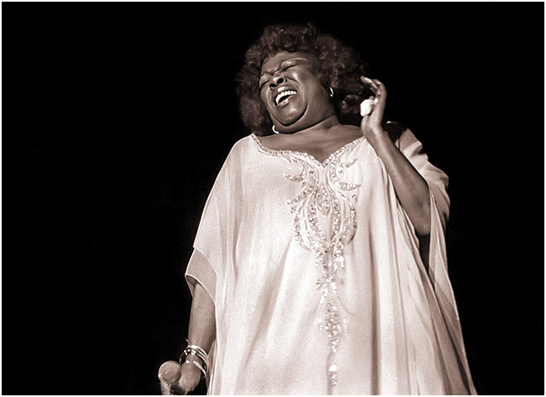
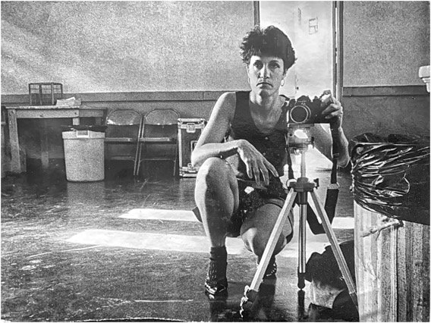
ATLANTA SELECTIONS WHERE IT ALL BEGAN (1979-1985)
ME
Atlanta (circa mid 80’s)
SARAH VAUGHAN
Atlanta Free Jazz Festival,1 983

Slide 2
MILES!
Atlanta Free Jazz Festival, Atlanta Auditorium 1983

Slide 3
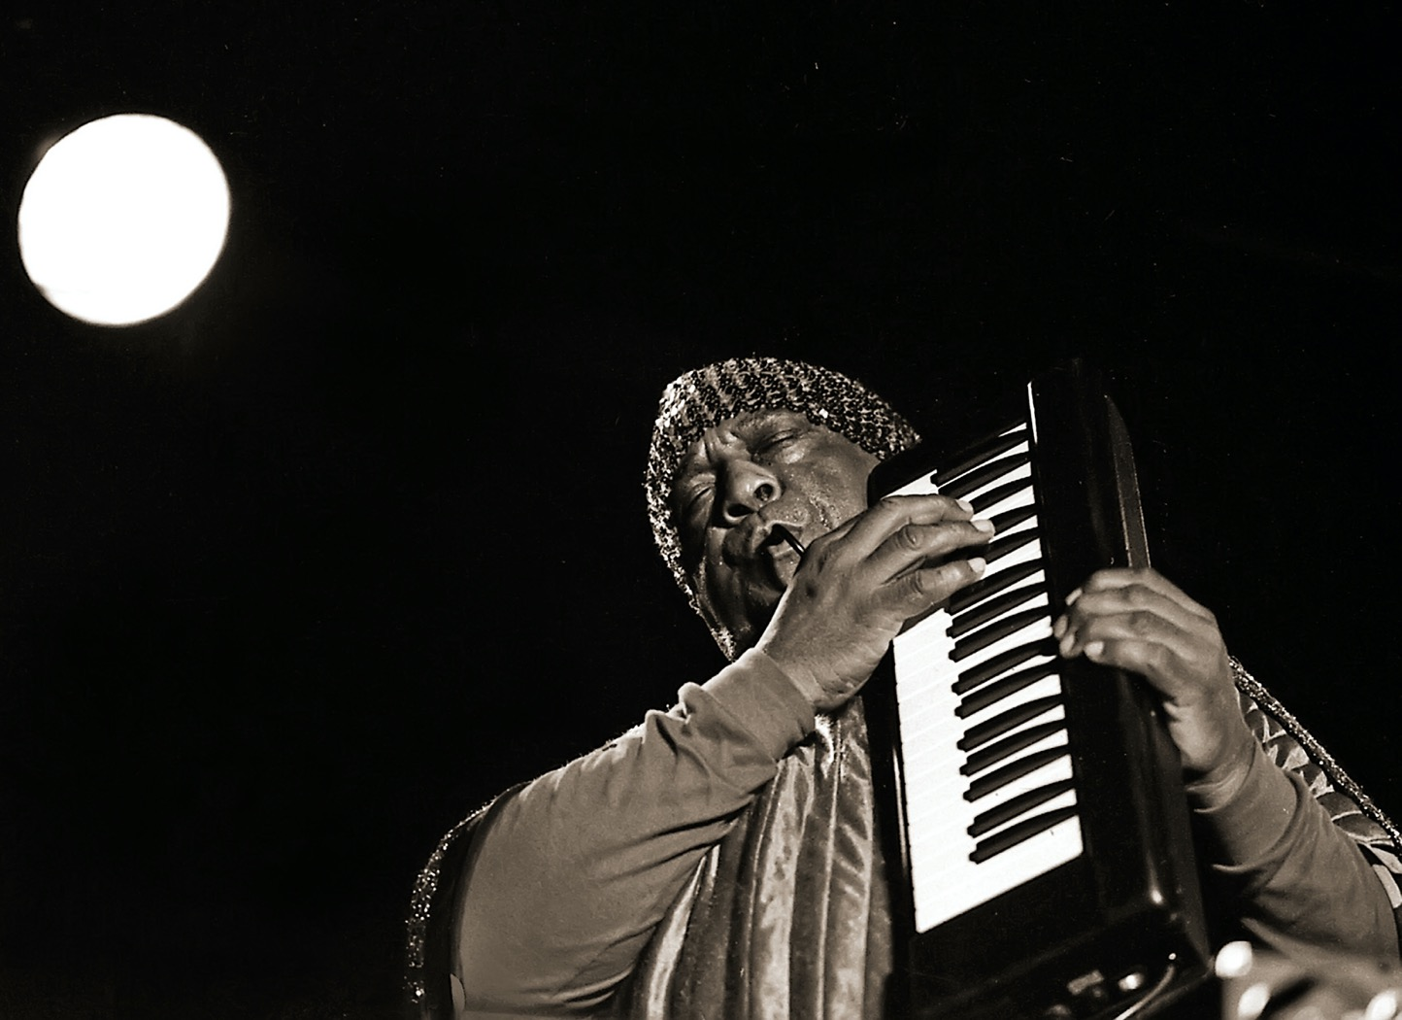
“THE SUN AT THE MOON”
SUN RA
Moonshadow Saloon
Atlanta 1993

Slide 4
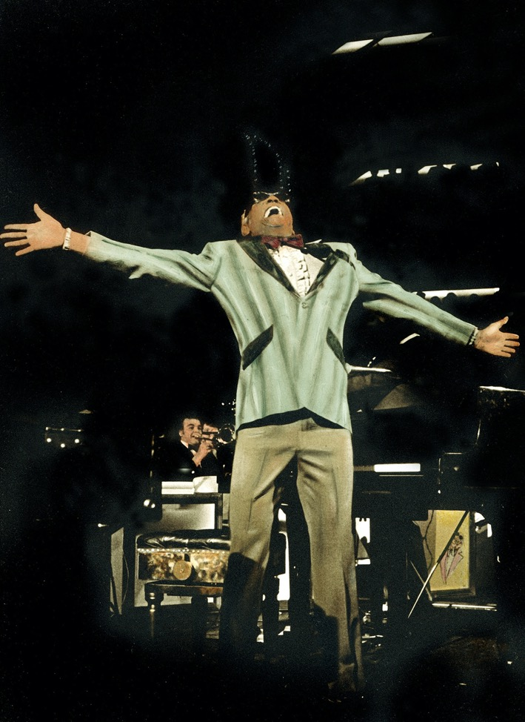
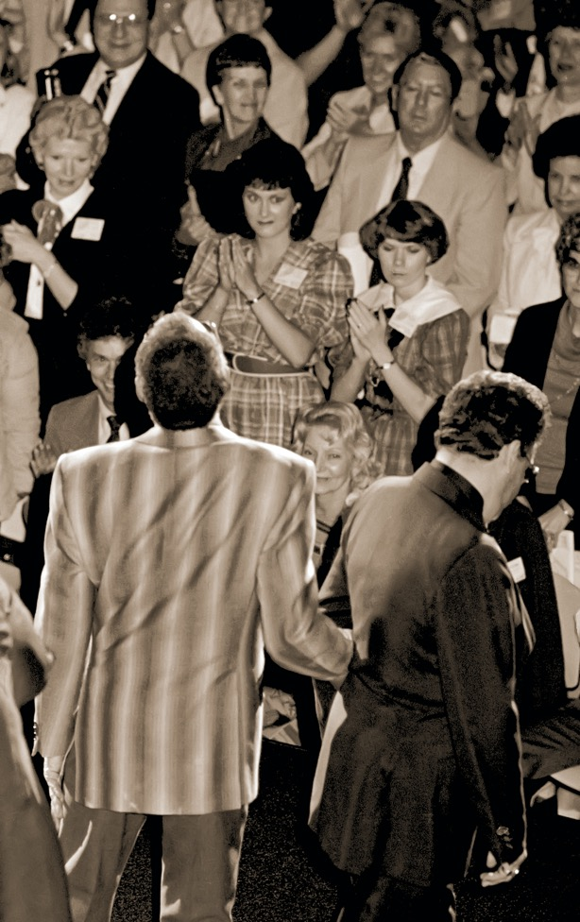
RAY CHARLES Merchandise Mart, Atlanta 1983

Slide 5
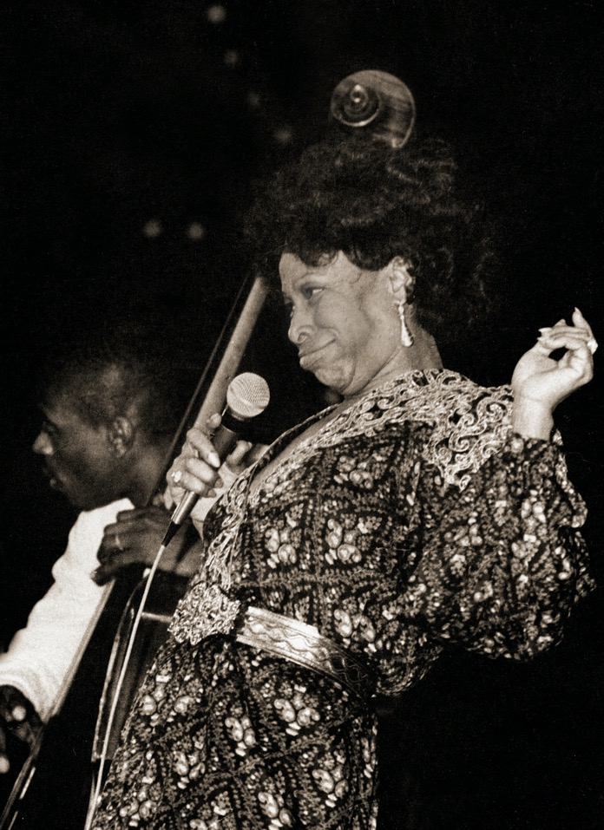
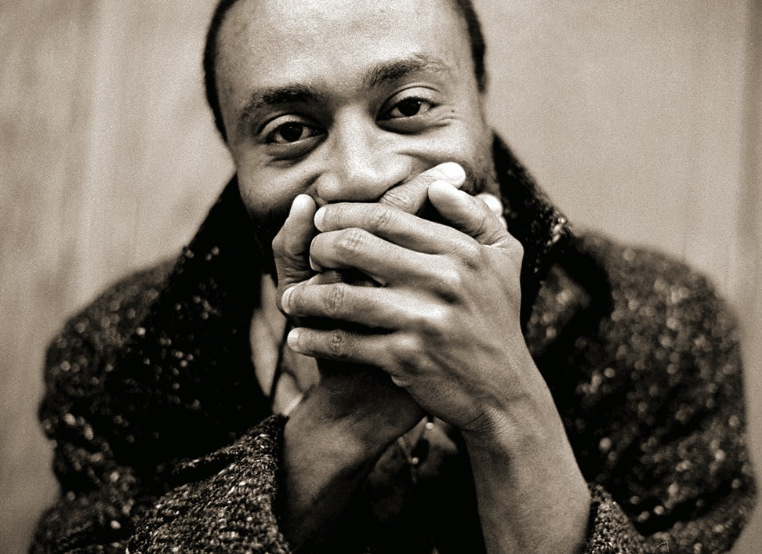
BOBBY MCFERRIN
Atlanta 1985
BETTY CARTER
Peachtree Playhouse, Atlanta 1982

Slide 6
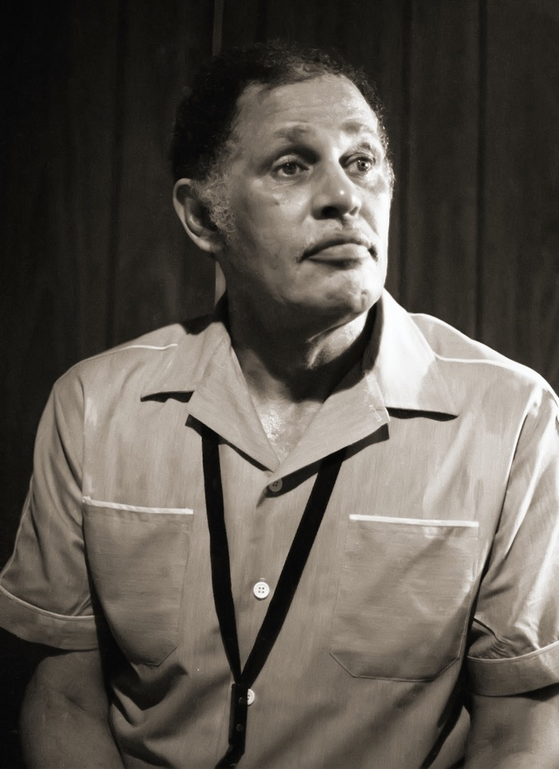
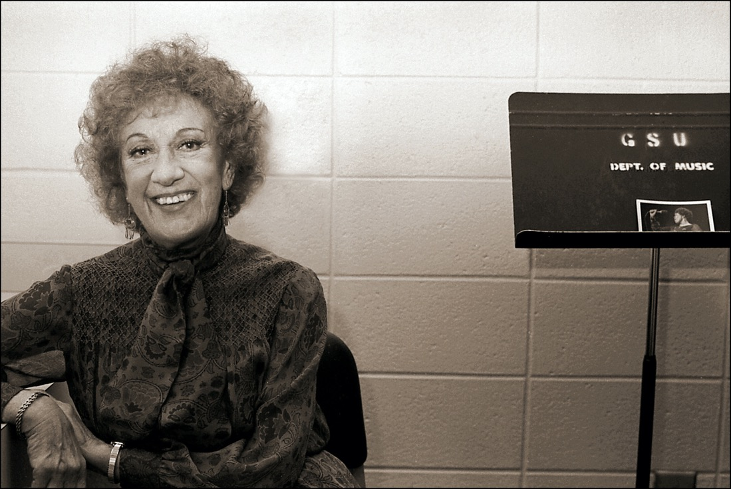
MARIAN MCPARTLAND
Atlanta, GA 1979
DEXTER GORDON
Atlanta, GA 1982

Slide 7
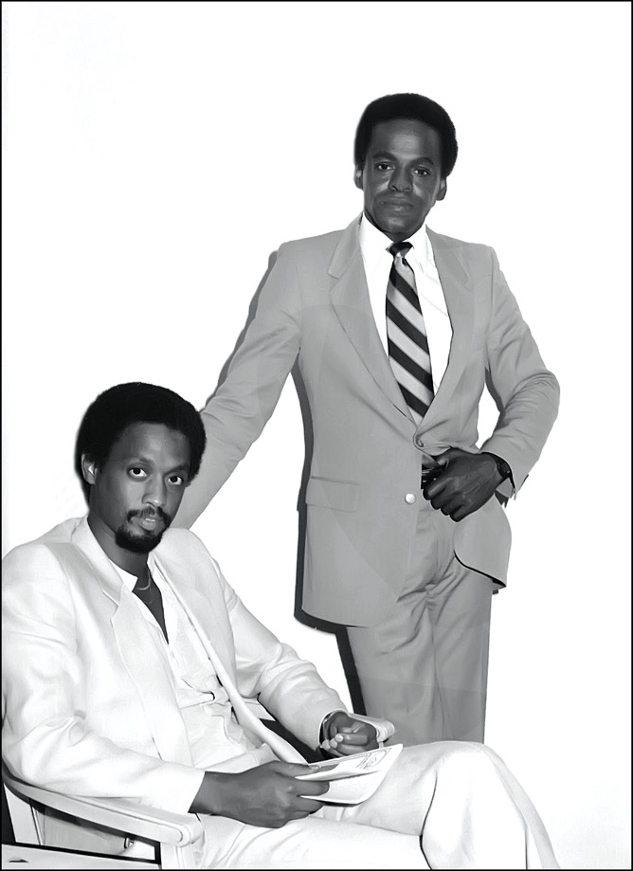
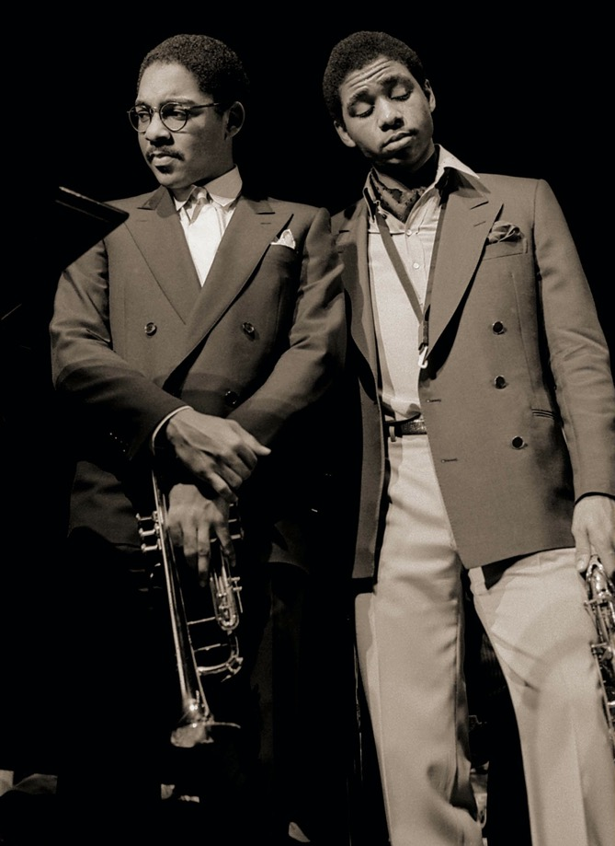
CHICO FREEMAN & CECIL MCBEE
Atlanta Free Jazz Fest. Piedmont Park, Atlanta, GA 1982
WYNTON & BRANFORD
Clark College, Atlanta, GA 1993

Slide 8
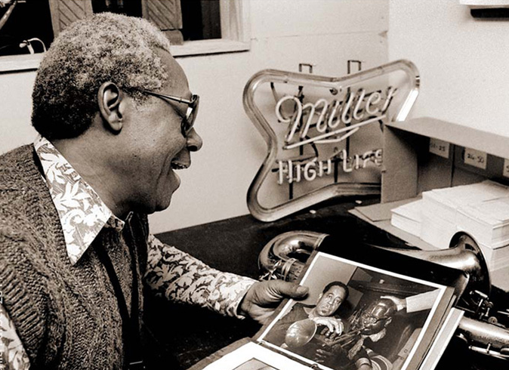
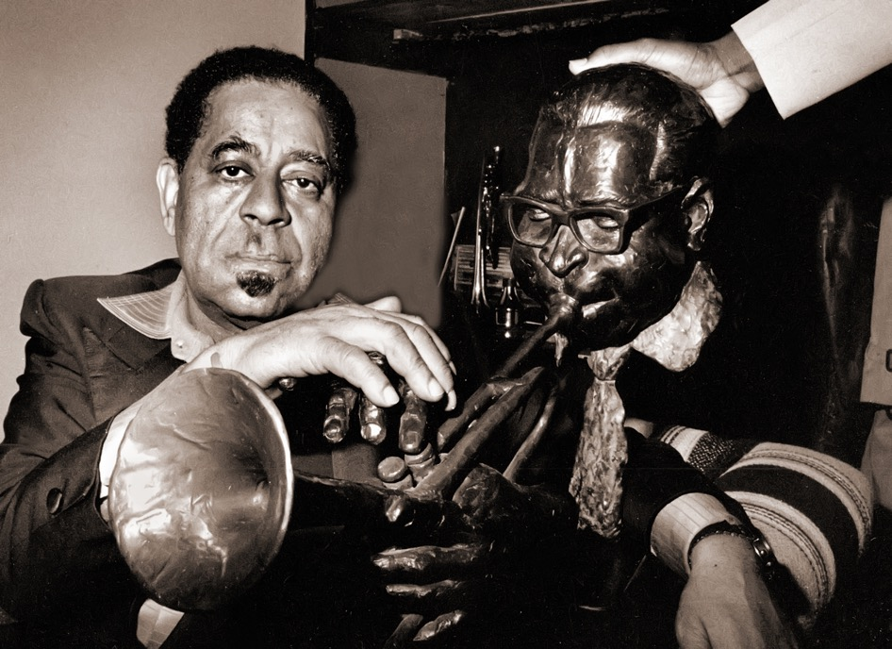
CHARLIE ROUSE & DIZ
The Point, Atlanta 1985
DIZ & DIZ
Backstage, Moonshadow Saloon, Atlanta 1984

Slide 9
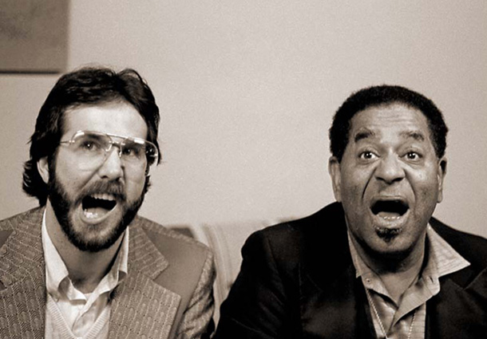
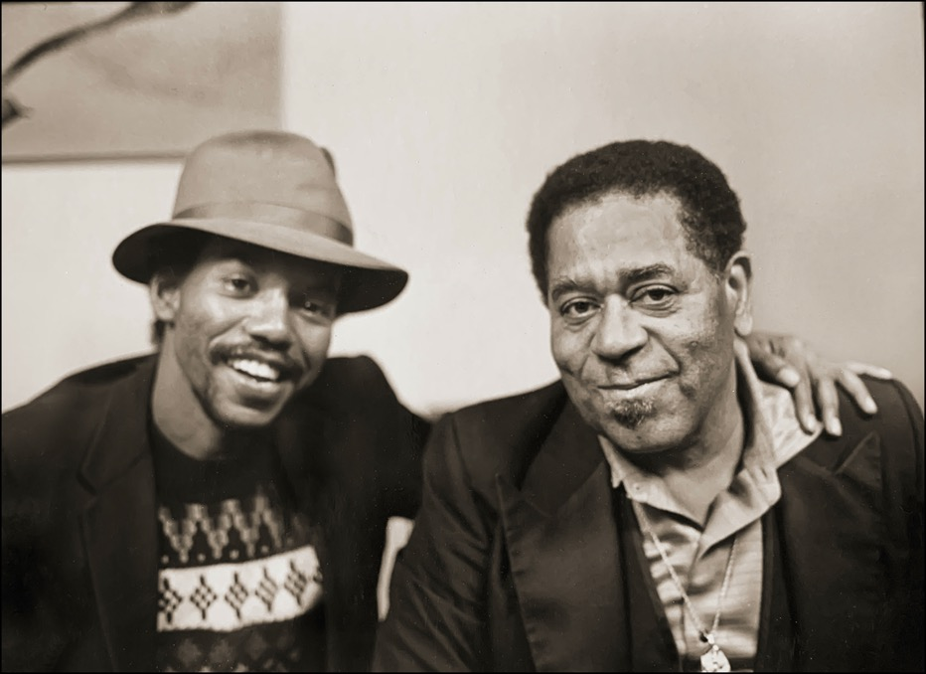
DIZZY GILLESPIE
Backstage, Moonshadow Saloon, Atlanta 1984
With CHRIS KUHL
With ERNIE GREGORY

Slide 10
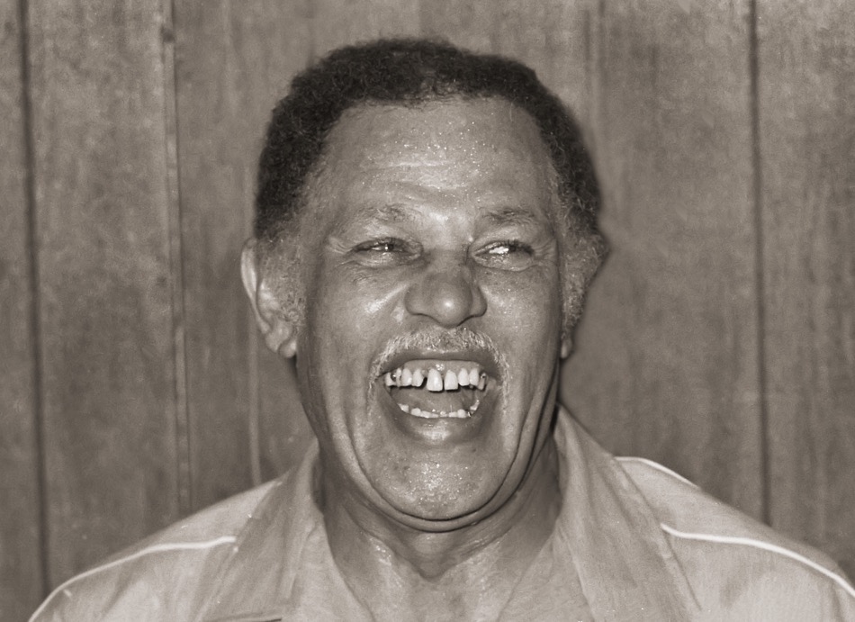
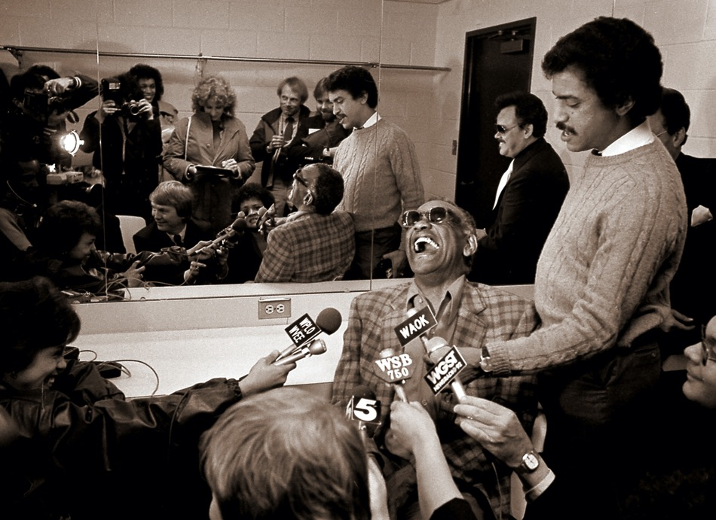
DEXTER GORDON
Atlanta, 1982
RAY CHARLES
Atlanta, 1983

Slide 11
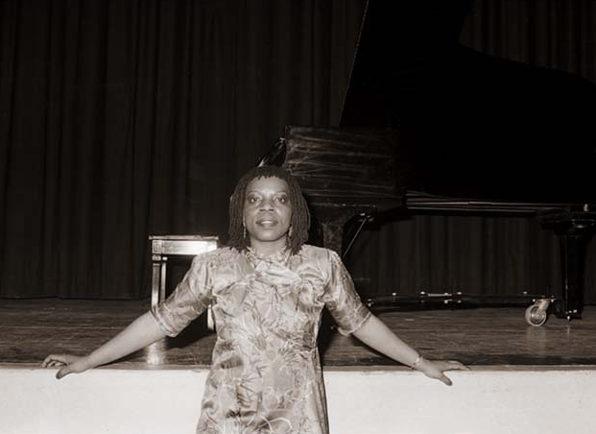
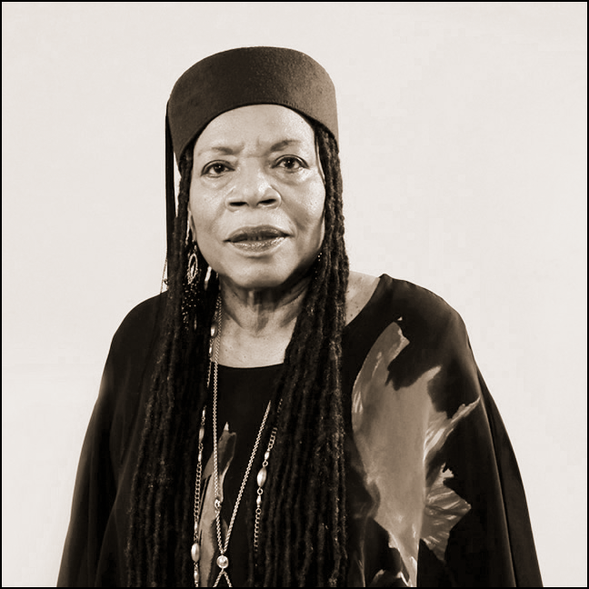
AMINA CLAUDINE MYERS
Atlanta 1982
Octaven Recording Studio, Mt. Vernon, NY 2021

Slide 12
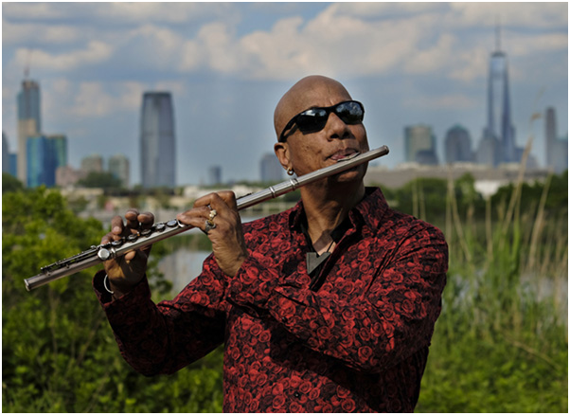
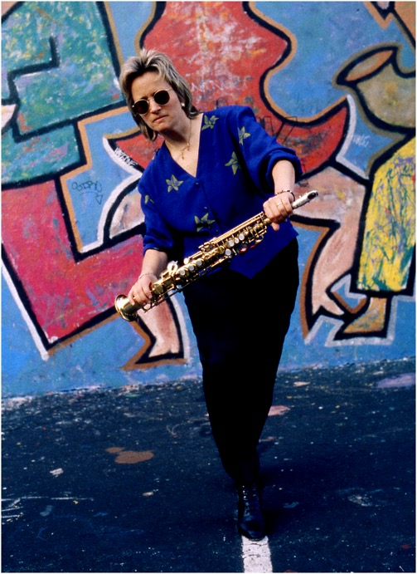
NEW YORK CITY & BEYOND SELECTIONS (1985-Present)
T.K. BLUE
Jersey City 2019
JANE IRA BLOOM
New York City 1993

Slide 13
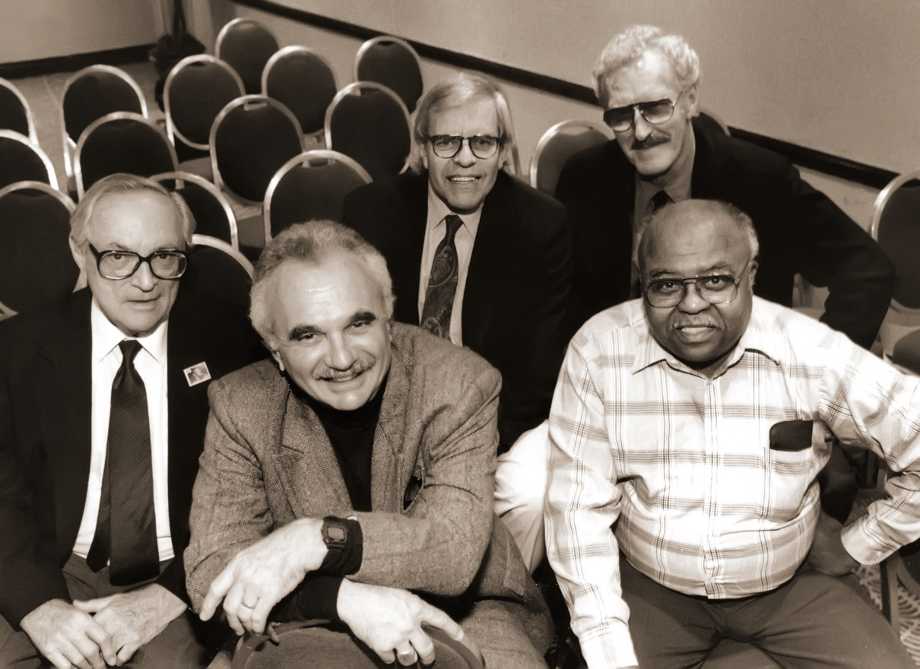
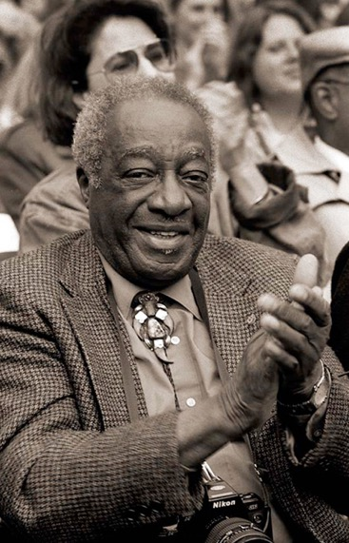
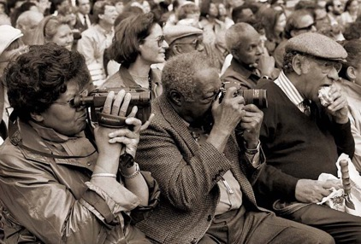
WHAT’S WRONG WITH THIS PICTURE?!
“FATHERS” OF JAZZ PHOTOGRAPHY
WILLAM GOTTLIEB, LEE TANNER, CHUCK STEWART, DAVID REDFERN & WILLIAM CLAXTON
Hilton Hotel, New York City 1994
MILT HINTON
Lincoln Center, New York City 1992

Slide 14
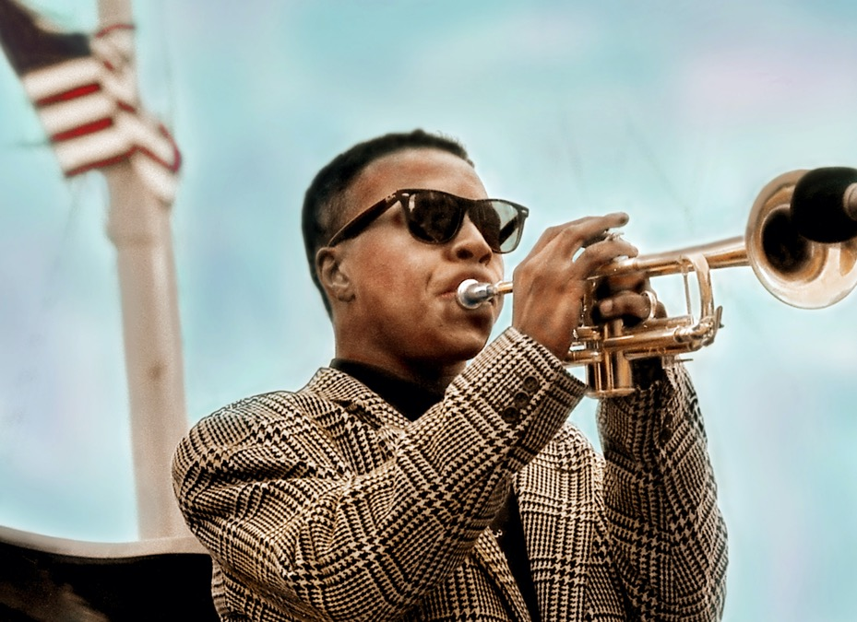
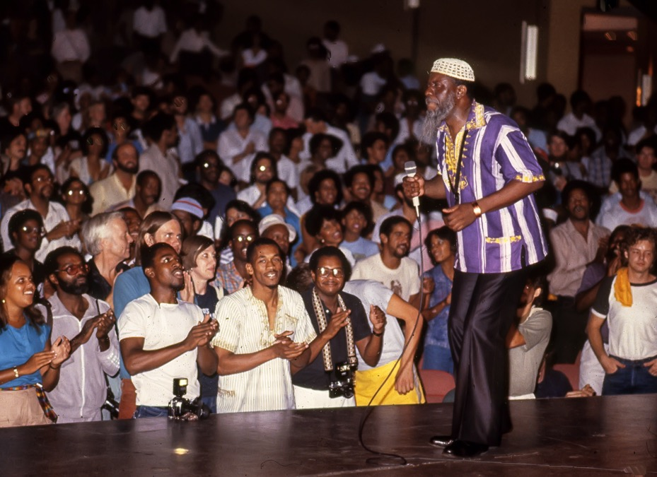
ROY HARGROVE
South Street Seaport, New York City 1991
PHAROAH SANDERS
Atlanta Free Jazz Fest, Atlanta 1984

Slide 15
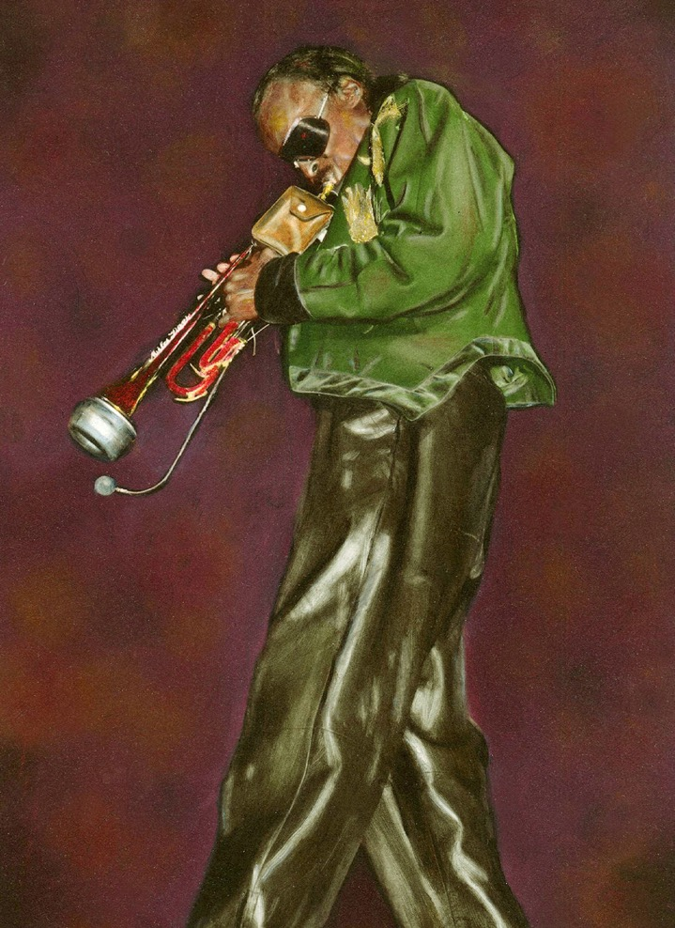
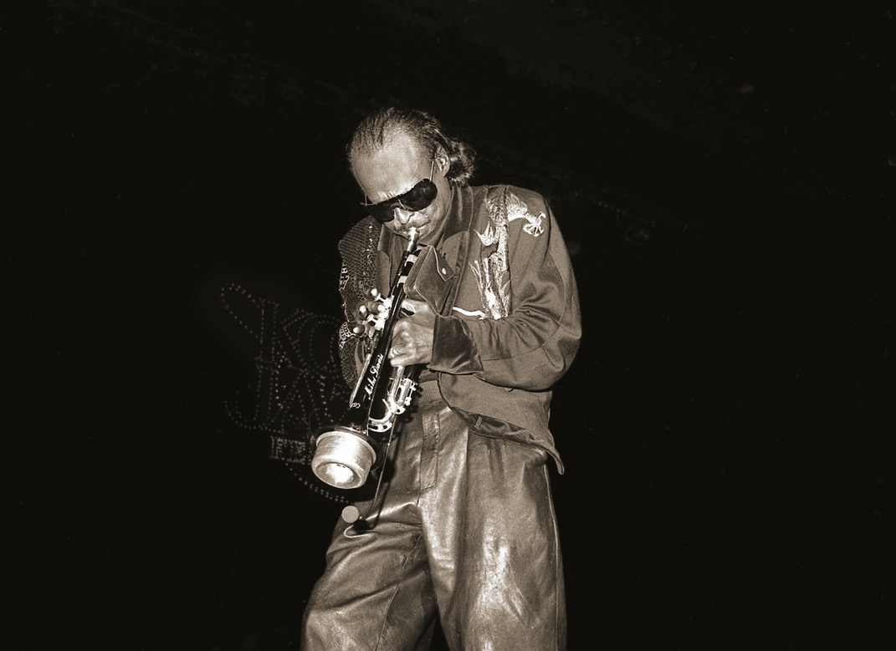
MIlES!
Kool Jazz Fest, Saratoga Springs, NY 1985

Slide 16
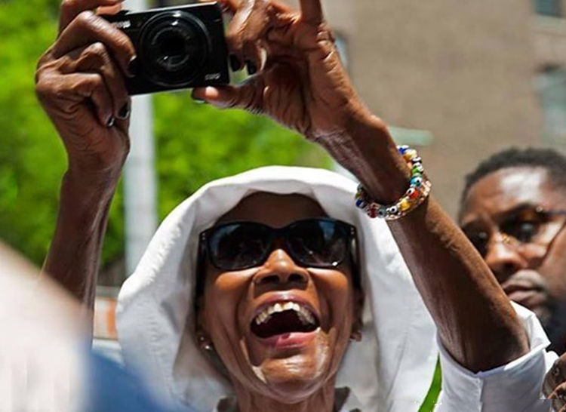
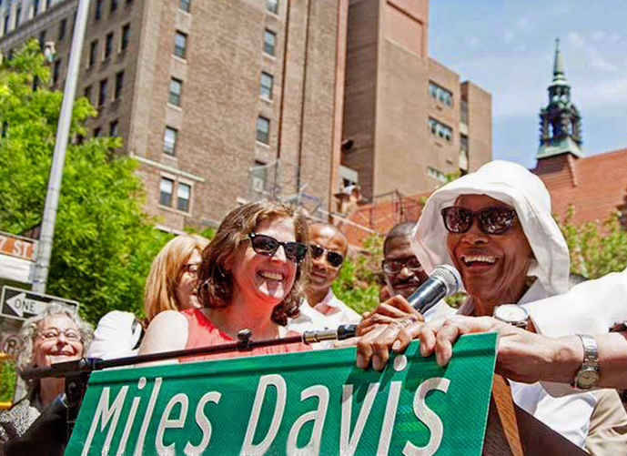
CICELY TYSON
Miles Davis Way Dedication, W, 77th Street New York City 2014

Slide 17
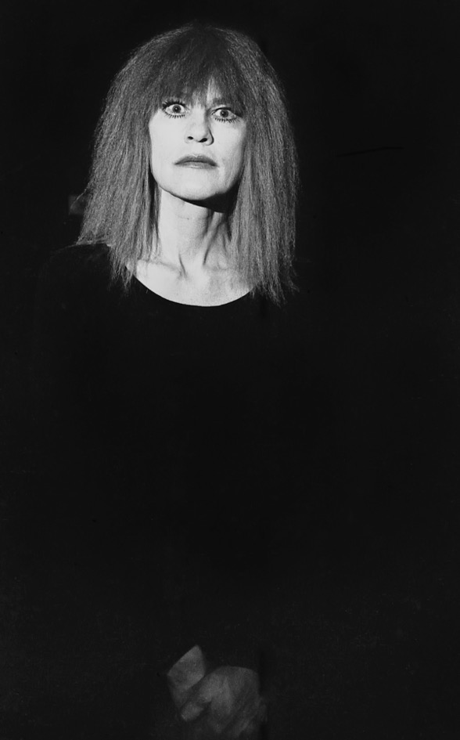
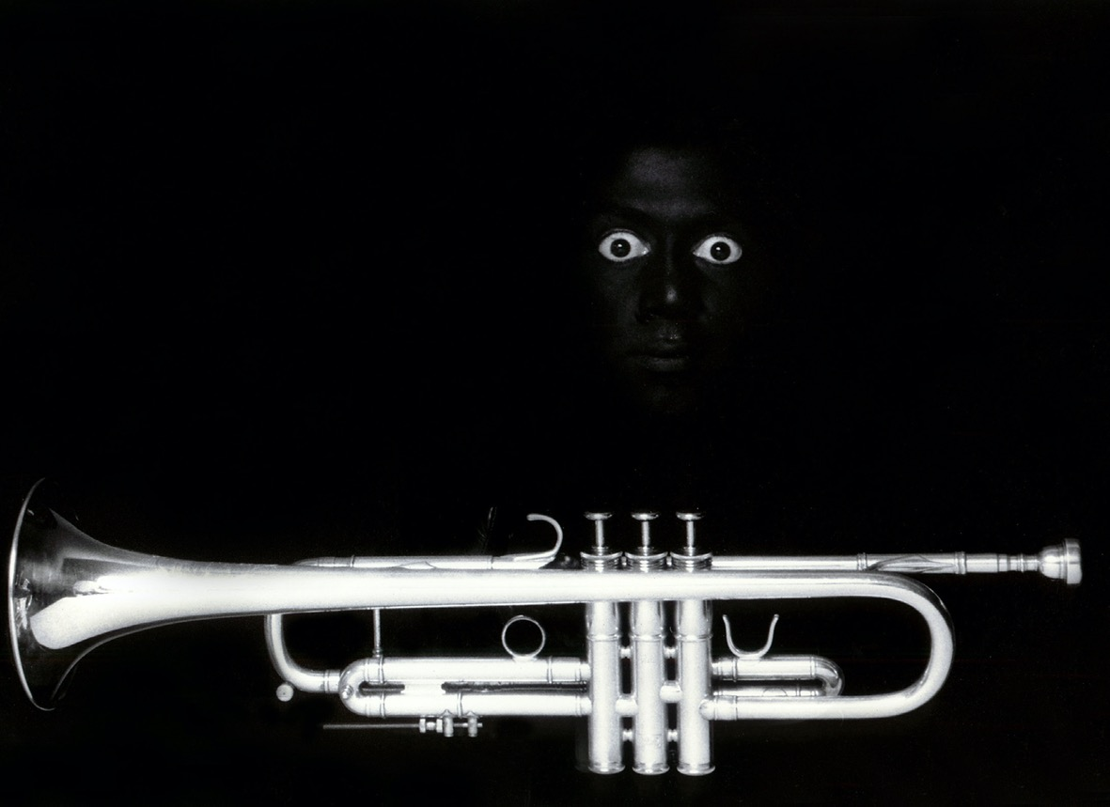
CARLA BLEY
St. John’s The Divine, New York City 1987
OMAR KABIR
My Place, New York City 1991

Slide 18
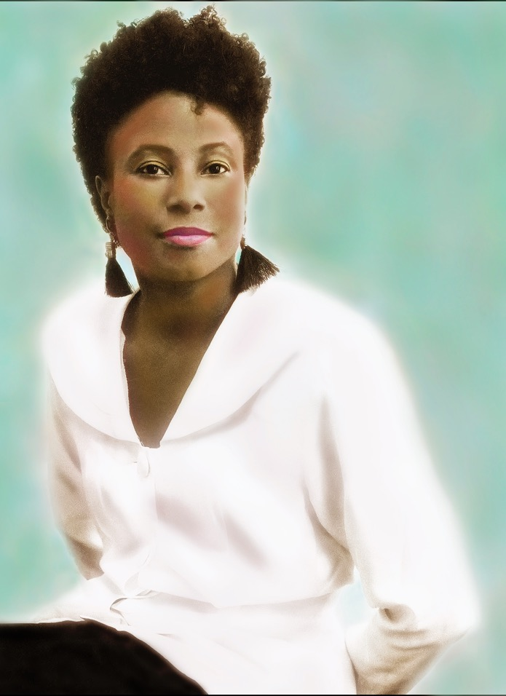
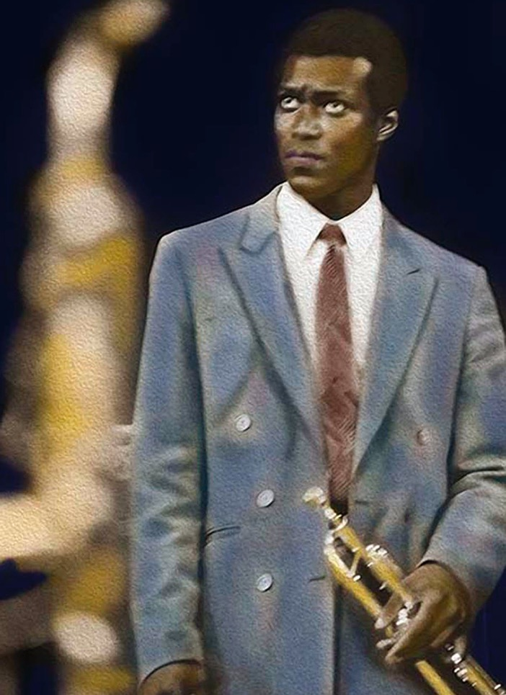
GERI ALLEN
Backstage, Carnegie Hall, New York City 1990
WALLACE RONEY
Kool Jazz Fest, Saratoga Springs, NY 1985

Slide 19
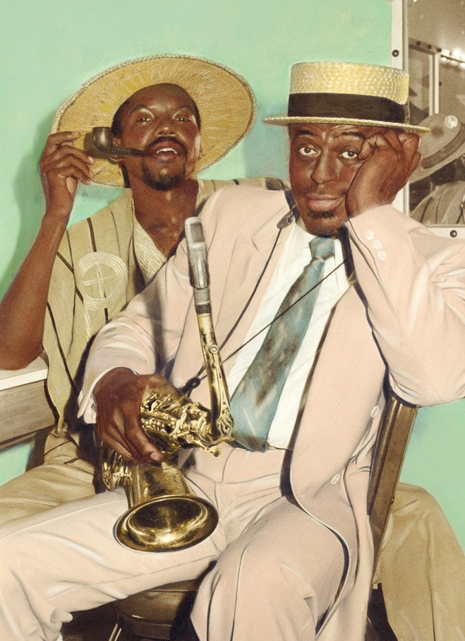
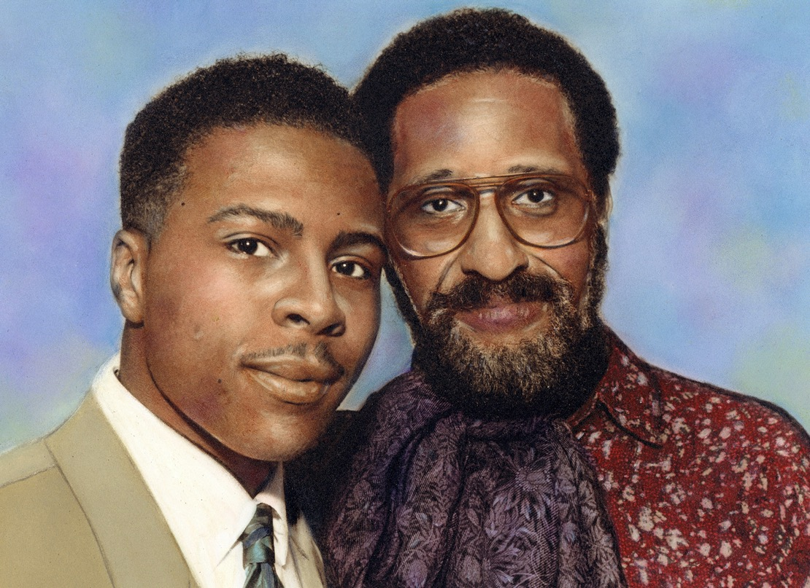
ROY HARGROVE & SONNY ROLLINS
Backstage, Carnegie Hall, New York City 1991
ARCHIE SHEPP & ERNIE GREGORY
Backstage, Atlanta 1984

Slide 20
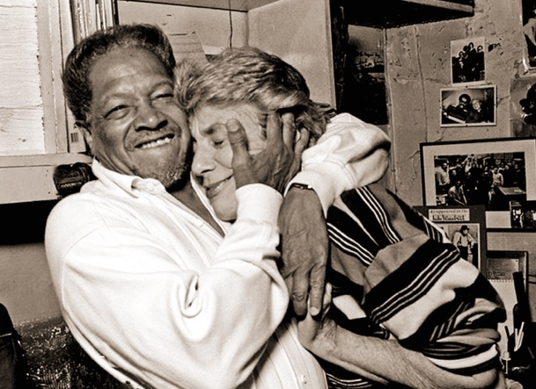
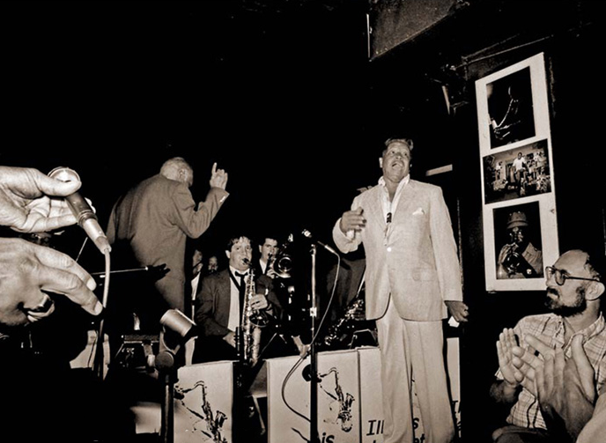
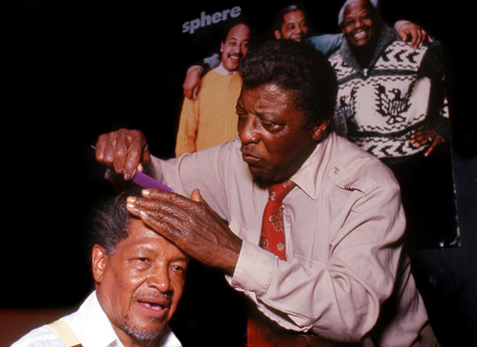
ILLINOIS JACQUET
Village Vanguard, New York City 1998
Backstage with LORRAINE GORDON
In the Club with Personal Hairdresser ROGER SIMON

Slide 21
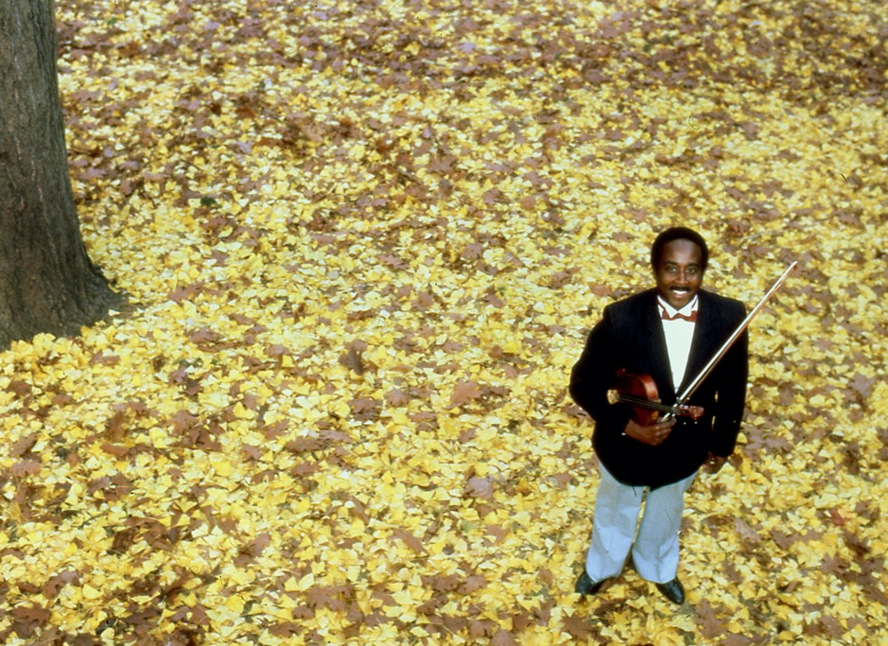
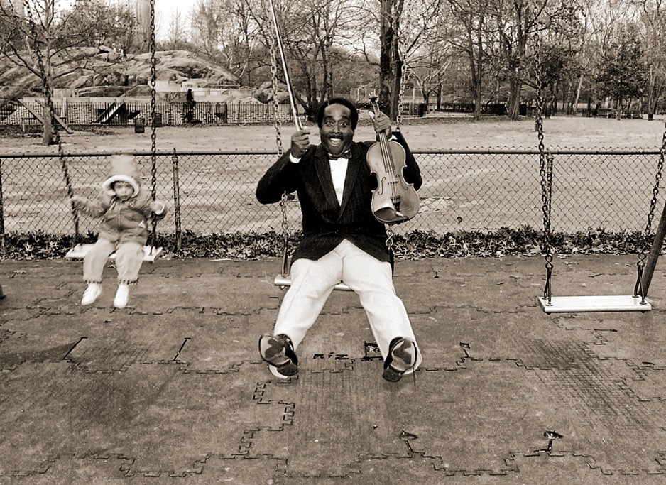
JOHN BLAKE
Central Park, New York City 1986
“It Don’t Mean a Thing, If It Ain’t On That Swing”!

Slide 22
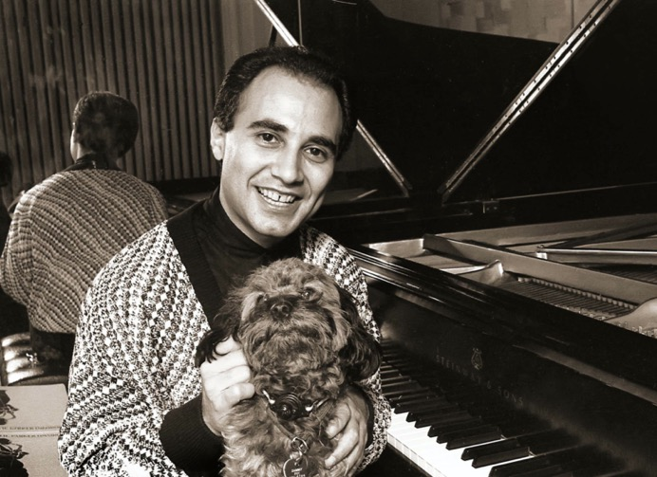
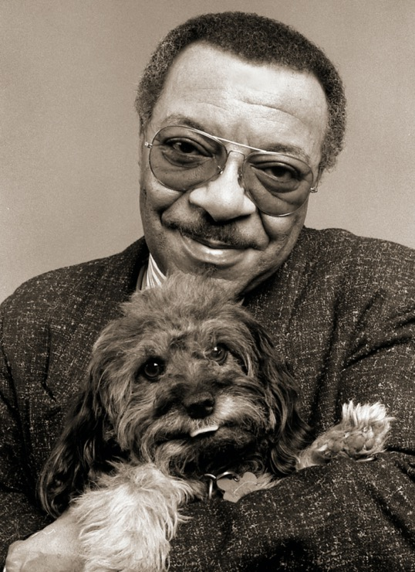
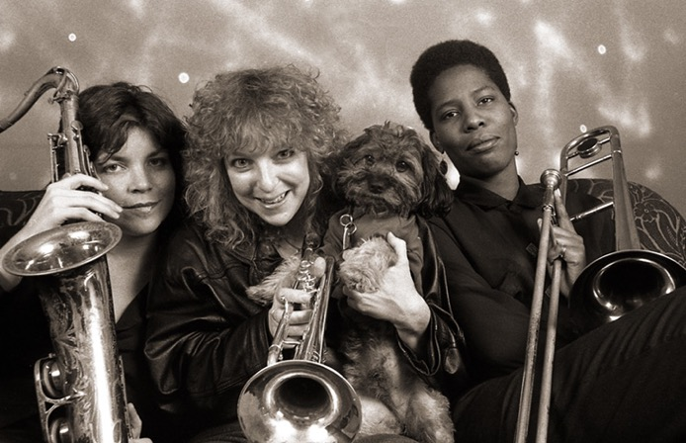
AND THEN SAMMY WALKED IN!
With MICHEL CAMILLO
Michel’s Place, New York City 1989
With BURNING BRASS
My Place, Jersey City 1990
With GRADY TATE
My Place, New York City 1991

Slide 23
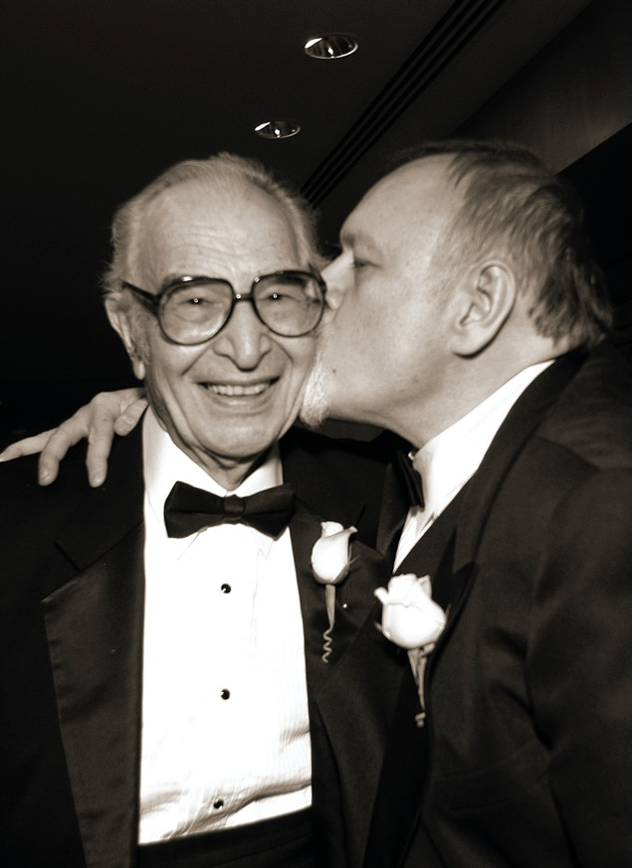
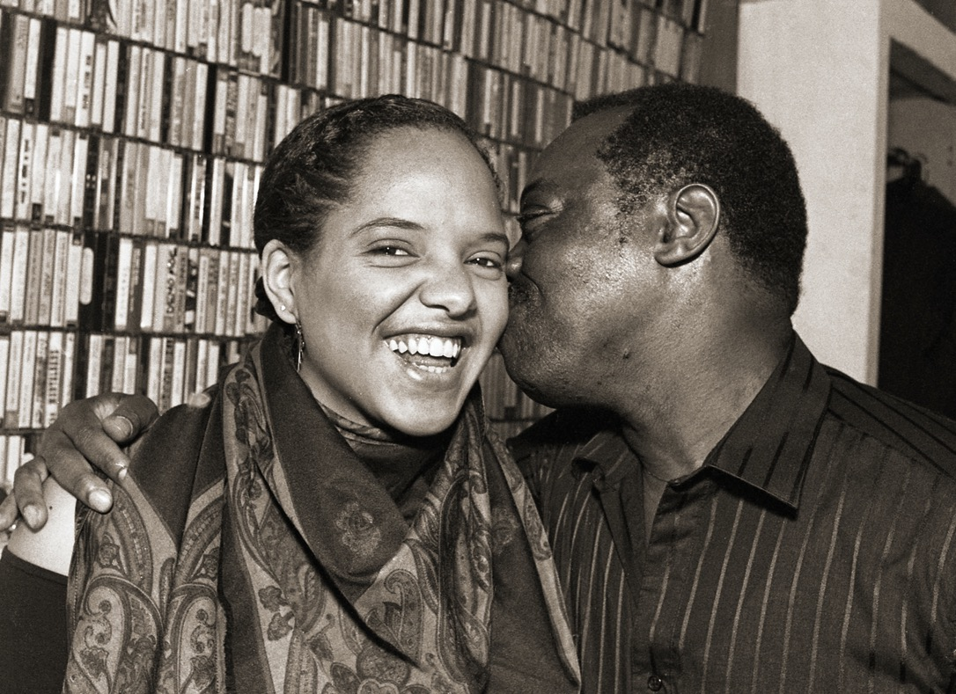
DAVE BRUBECK & MICHAEL BOURNE
WBGO Gala, Ritz Hotel, New York City 2004
TERRI LYNE CARRINGTON & ANDREW CYRILLE
Backstage, Knitting Factory, New York City 1990

Slide 24
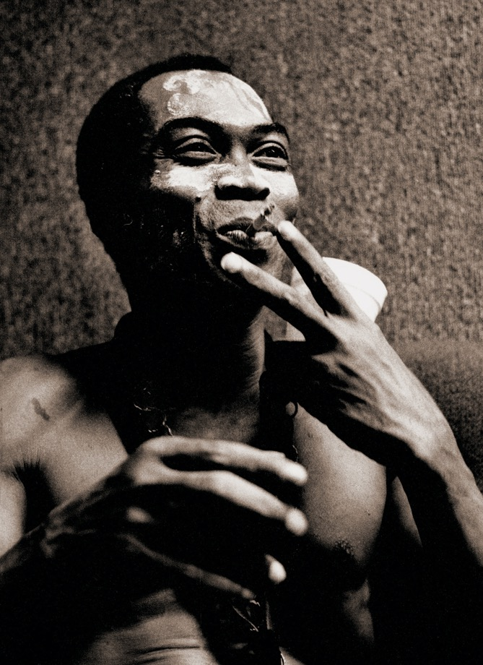
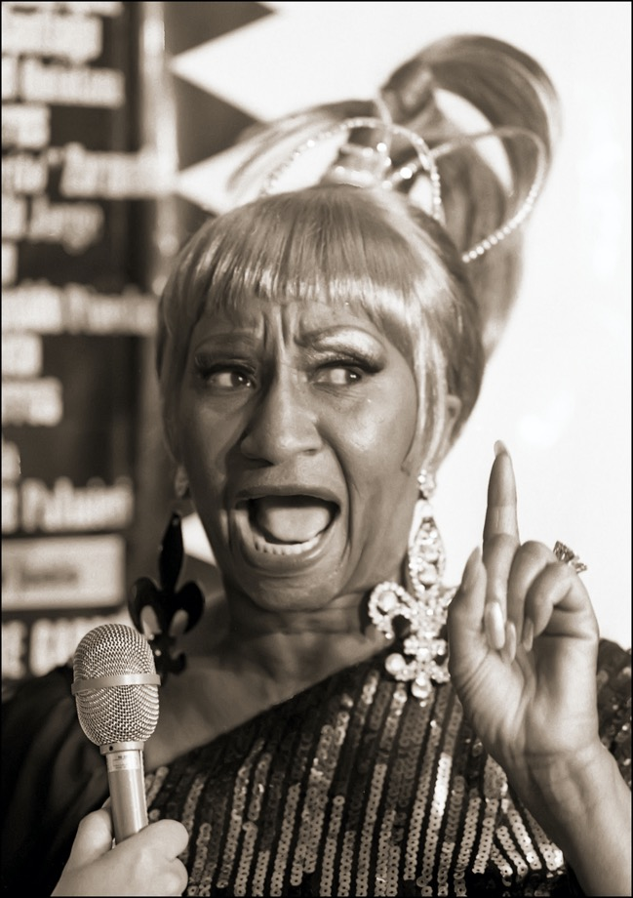
FELA KUTI
Backstage, Felt Forum, New York City 1986
CELIA CRUZ
Backstage, Madison Square, Garden, New York City 1994

Slide 25
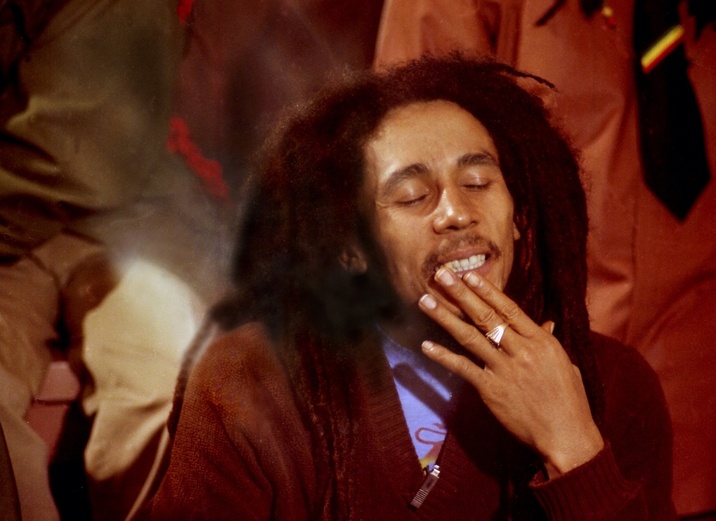
BOB MARLEY
Backstage, Fox Theater, Atlanta 1979
ALICE COLTRANE
Joe’s Pub, New York City 2002

Slide 26
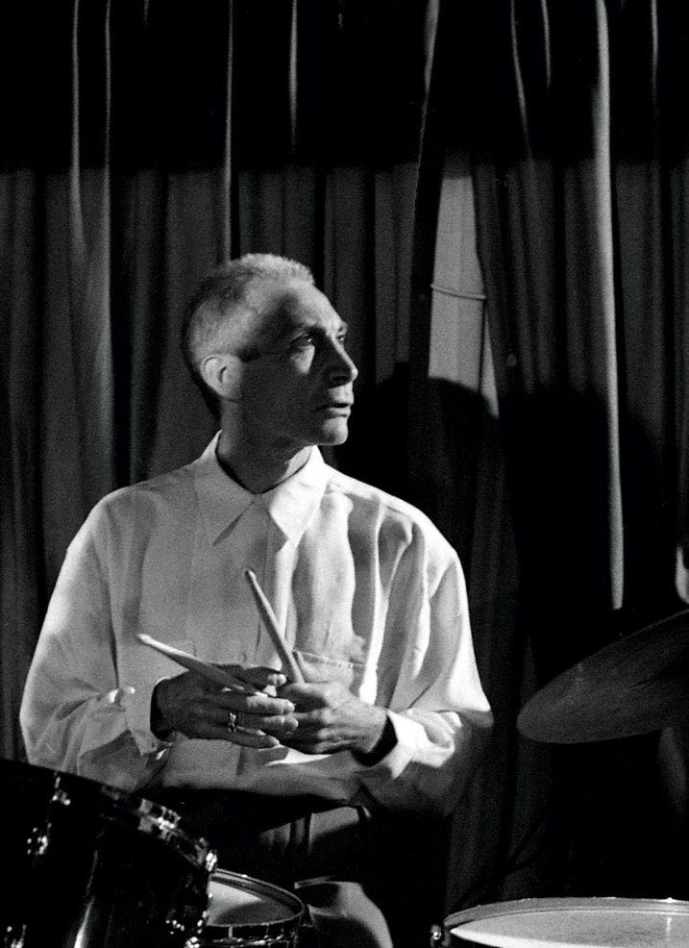
CHARLIE WATTS
Birdland, New York City 1991
RAVI COLTRANE
Summerstage, Central Park, New York City 2019

Slide 27
HAROLD MABERN
CNN Headquarters, New York City 2015
GERI ALLEN
Backstage, Carnegie Hall, New York City 1990

Slide 28
ANTOINE RONEY
MilesDavis.com Concert,
Birdland, New York City 1998

Slide 29
BILL COSBY & TITO PUENTE
Village Gate, New York City 1990
MICHEL PETRUCCIANI
Birdland, New York City 1997

Slide 30
MILFORD GRAVES
Vision Fest, Judson Memorial Church, New York City 2015
With Peter Brotzman, Vision Fest, The Center, New York City 2003

Slide 31
VISION FESTIVAL SCENES
WILLIAM PARKER & CHARLES GAYLE
Judson Memorial Church, New York City 2015
JOHN ZORN & FAN
Orensanz Theater, New York City 2012

Slide 32
BILL CLINTON & DIZZY GILLESPIE MEMORIAL BAND
(Claudio Roditi, Byron Dean, Clark Terry, Wynton Marsalis, Roy Hargrove, Jon Faddis, Donald Byrd)
New York City 1991 & 1992
BILL CLINTON
Club Tatou, New York City 1992

Slide 33
WYNTON & CLINTON
Jazz and Democracy, Walter Reade Theater, New York City 2003
AL JARREAU & JON HENDRICKS
New York City 1996

Slide 34
BURNING BRASS
(Pam Fleming, Nilda Richards & Jenny Hill)
Meat Packing District, New York City 1990
SONNY SHARROCK & VERNON REID
My Place, Upper East Side, New York City 1993

Slide 35
HENRY GRIMES
New York City 2016
BRANDON ROSS, HENRY GRIMES, J.T. LEWIS
Henry’s 80th Birthday Celebration, New York City 2015

Slide 36
CLAIRE DALY Poughkeepsie, NY 2001
JAZZ JOURNALISTS ASSOCIATION 2002 PHOTO OF THE YEAR

Slide 37
CLAIRE DALY
Hudson Valley, NY 2000
ALLAN HARRIS
Central Park New York City 2003

Slide 38
HERBIE HANCOCK
Blue Note, New York City 1987
Entering Green Room
Women’s Bathroom
Me Feeding Him a Grape!

Slide 39
DON CHERRY, ED BLACKWELL & DON PULLEN
Blackwell Project, Riverside Church, New York City 1990
ART ENSEMBLE OF CHICAGO
S.O.B.’s, New York City 1987

Slide 40
WADADA LEO SMITH RECORDING SESSIONS FOR TUM RECORDS
WADADA, AMINA CLAUDINE MYERS, ANDREW CYRILLE, VIJAY IYER
Octaven Recording Studio, Mount Vernon, NY 2021
MATTHEW GARRISON, WADADA & JACK DEJOHNETTE
Berklee Power Station, New York City 2023

Slide 41
ARCHIE SHEPP & WIFE
Rehearsal for 2022 Charlie Parker Jazz Festival, GSI Studios, New York City 2023

Slide 42
HENRY GRIMES
Vision Fest, Judson Church, New York City 2016
MARSHALL ALLEN
Winter Jazz Fest, Opera House, Williamsburg, Bklyn 2023

Slide 43
MARSHALL ALLEN-98 YEARS YOUNG!
Shapeshifter Lab, Brooklyn 2023

Slide 44
DIANA ROSS
Music With Friends, Charlotte, NC 2011
SAMARA JOY
Winter Jazz Fest, Le Poisson Rouge, New York City 2023

Slide 45
ABBEY LINCOLN
Great Night in Harlem, Apollo Theater, New York City 2002
RANDY WESTON
Caramoor Jazz Fest, Katonah, NY 1998

Slide 46
LILA DOWNS
Prospect Park, Brooklyn 2017
SWEET GEORGIA BROWN & BRUCE WILLIS
Great Night in Harlem, Apollo Theater, New York City 2019

Slide 47
GLADYS KNIGHT
Jazz Foundation Loft Party, New York City 2017
CHARLIE WATTS
Charlie Parker Tribute Band, Birdland, New York City 1990

Slide 48
ELLA FITZGERALD
Chastain Park, Atlanta 1982
BOBBY MCFERRIN
“Hearts For Ella”, JALC, New York City 1990

Slide 49
D.D. JACKSON & JOHN HICKS
Manhattan Ballroom, Jazz Journalists Awards, New York City 1997
RANDY WESTON & DR. CORNELL WEST
Jazz Foundation Loft Party, New York City 2015

Slide 50
SNIT AT THE KNIT!
Knitting Factory, New York City 1998
MATT SHIPP & STANLEY CROUCH
STANLEY. GENE FOURTON &?

Slide 51
WESSELL ANDERSON & BABY
New York City 1990
RALPH PETERSON & SONORA
Blackwell Project, Riverside Church, NYC 1990
Blackwell Project Tribute, Knitting Factory, NYC 1990

Slide 52
JEFF “TAIN” WATTS
Ed Blackwell Project, Riverside Church, New York City 1990
STEVE SWALLOW
Rooftop, Howard Johnson’s Motel, New York City 1992

Slide 53
FATHER AND SON
20 Years Apart
JACO PASTORIUS
Rumours, Atlanta 1982
FELIX PASTORIUS
Winter Jazz Fest, Le Poisson Rouge, NYC 2012

Slide 54
PERCUSSIONISTS POST MAX ROACH FUNERAL
Grant’s Tomb, New York City 2007

Slide 55
GROWING MATTHEW WHITAKER
Apollo Theater, NYC 2014
Montclair, NJ 2022
Home, NJ 2016
Apollo Theater, NYC 2013

Slide 56
EDDIE PALMIERI
S.O.B.’s, New York City 1994
ORNETTE COLEMAN
Hofstra Univ. Long Island 1987

Slide 57
GREAT NIGHT IN HARLEM
Apollo Theater, New York City 2023
BLIND AUDITIONS RALLY
Columbus Circle, New York City 2015
Danny Glover , Jarrett Lilien, Wendy, Mike Novogratz, Dick Parsons,
Chris and Pam Fleming

Slide 58
JAZZIZ MAGAZINE “WOMEN IN JAZZ” INTERVIEW
New York City 2000
JJA WOMEN WINNERS (PARTIAL)
New York City 2018
(Front) Barbara Carroll, Cassandra Wilson, Myra Melford,
(Back) Claire Daly, Carla Bley, Cindy Blackman, Leni Stern
Tomeka Reid, Patrica Willard, Claire Daly, Jane Ira Bloom, Nicole Mitchell

Slide 59
CLAIRE DALY
Recording Studio, New York City 2000
NICOLE MITCHELL
Vision Fest, New York City 2017
CASSANDRA WILSON
Carnegie Hall, New York City 2000

Slide 60
TOMEKA REID
The Stone, New York City 2019
BRANDEE YOUNGER
Winter Jazz Fest, Brooklyn 2023

Slide 61
NINA SIMONE
Hunter College, New York City 1985
CINDY BLACKMAN-SANTANA
Knitting Factory, New York City 1997

Slide 62
LAKECIA BENJAMIN & JAZZMEIA HORN
Charlie Parker Festival, New York City 2019
KEITH RICHARDS & WENDY OXENHORN
Great Night in Harlem, Apollo Theater, New York City 2015

Slide 63
INDIA ARIE
Barbados 2004
JAZZMEIA HORN
New York City 2019

Slide 64
DIANNE REEVES
Singer AND Photographer!
New York City 1997
Union, NJ 2022

Slide 65
NANCY WILSON
JVC Jazz Fest. Carnegie Hall, New York City 2007
CLAUDIA ACUNA
Montclair Jazz Festival, 2022

Slide 66
ABBEY LINCOLN
New York City 1996
JAZZMEIA HORN
New York City 2016
CASSANDRA WILSON
New York City 2000

Slide 67
A FEW NOTABLES WHO HAVE PASSED THROUGH MY LENS
LIONEL HAMPTON
Atlanta 1982
HAMP
New York City 1992

Slide 68
CHICK COREA
OLDER CHICK
Blue Note,New York City 2016
YOUNG CHICK
Atlanta 1982

Slide 69
HENRY GRIMES & MARGARET DAVIS GRIMES
Visiting Me in Hell’s Kitchen,
New York City 2003
Charlie Parker Festival, New York City 2015
New York City 2016

Slide 70
INDUSTRY TITANS
YVONNE ERVIN & JOE LOVANO
New York City 2010
PHIL SCHAPP & SHEILA JORDAN
New York City 2007

Slide 71
MAX ROACH’S FUNERAL
Riverside Church, New York City 2007
PHILSCHAPP & MAX ROACH’S DRUMS
AMIRI BARAKA, SONNY ROLLINS, CHARLES RANGEL,
BILL COSBY & PHIL SCHAPP

Slide 72
MILES DAVIS MEMORIAL, ST. PETER’S CHURCH
New York City 1991
DIZZY GILLESPIE
WAYNE SHORTER & HERBIE HANCOCK

Slide 73
SONNY SHARROCK
New York City 1993
LARRY HARLOW
New York City 2004
JULIUS HEMPHILL
New York City 1994

Slide 74
MAX ROACH & BILLY HIGGINS
Ed Blackwell Memorial, St. Peter's Church, NYC 1992
Marian McPartland & Billy Taylor
WBGO 25th Anniversary Gala, Ritz Carlton, NYC 2004

Slide 75
CAB CALLOWAY
New School, New York City 1990
RAY BARRETTO
Blue Note, New York City 1987

Slide 76
MAL WALDRON
Bryant Park, New York City 1987

Slide 77
LITTLE JIMMY SCOTT
Hollywood, CA 1991

Slide 78
DAVID FATHEAD NEWMAN, ART BLAKEY & DR. JOHN
Art’s Home, Greenwich Village, New York City 1990
RALPH PETERSON & SON
Blackwell Project, Riverside Church, New York City 1990

Slide 79
BUTCH MORRIS
His Place, East Village, New York City 1991

Slide 80
ART FARMER
Upper West Side, New York City 1993
FRANK LOWE
Manhattan Plaza, New York City 1992

Slide 81
BARRY HARRIS 1990
Abyssinian Baptist Church, New York City
JAKI BYARD
Vision Fest, Orensanz, NYC 2009
KENNY KIRKLAND
Lobby, Beacon Theater, New York City 1991

Slide 82
ELVIN JONES
Backstage, Metropolis, New York City 2004
Blue Note, 72nd Birthday, Blue Note New York City 1999

Slide 83
CECIL TAYLOR & MAX ROACH
Ten Year Reunion, New York City 1989

Slide 84
TERRI & THOMAS CHAPIN
Knitting Factory, New York City 1997
CELIA CRUZ & TITO PUENTE
Backstage, Blue Note, New York City 1993

Slide 85
ASTOR PIAZZOLLA
Summerstage, Central Park, New York City 1990
CELIA CRUZ
Blue Note, New York City 1987

Slide 86
TITO PUENTE
Blue Note, New York City 1993

Slide 87
DEXTER MEMORIAL
Abyssinian Baptist Church, New York City 1990
DEXTER GORDON
Peachtree Playhouse, Atlanta 1982

Slide 88
BENNY CARTER
Charlie Parker Fest, Tompkins Square Park, New York City 1997
LIONEL HAMPTON
Town Hall, New York City 2011

